Slide 1
Reviewing your existing Data
Richard Sultana
Employer Liaison Officer

Slide 2
What will we cover in this workshop?
What types of data are important & why?
How to correct any errors with your data?
What we do with the data provided?
How the data affects the Fund, the employer and the member?
What can you do to make your data better & how will we help?

Slide 3
Data Reconciliation Exercise
1st December 2018 – 31st January 2019
Receive a file containing all data we hold for your members
Review and correct the data using Employer Self Service (ESS)
Confirm data is correct and return to penemployers@Northamptonshire.gov.uk
Valuation 2019 – Impact!

Slide 4
Year End Summary- CPF
555 Leavers
146 New Starters
121 New Employments
We will write to you to advise you of your individual numbers

Slide 5
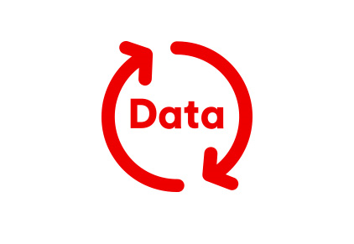
Why is the data received so important?
The data we hold for each member of the scheme is critical to determine the results of the valuation.
Incorrect data can have an impact on the following:
members pension benefits,
your employer rates
the funding level of the scheme as a whole

Slide 6
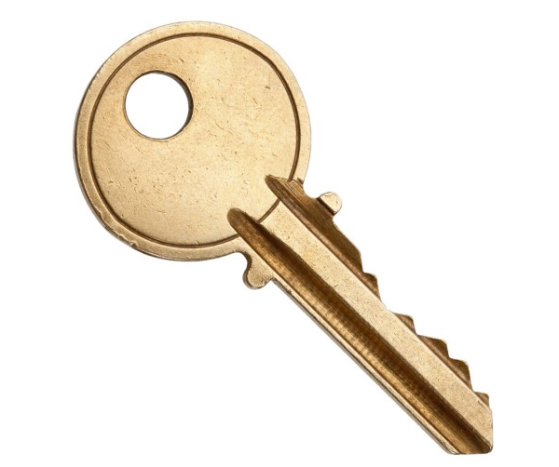
Key Data items
Final Pensionable Pay
Cumulative Pensionable Pay (CPP)
Assumed Pensionable Pay (APP)
Membership Details
Employee Contributions
Employer Contributions

Slide 7
Impact of Incorrect Data – Pensionable Pay
Active member example – figures and calculations are for illustrative purposes only
Sex | DOB | Start Date | FTE Salary £ | Liability £
M | 01/01/1954 | 01/01/1998 | 10,500 | 50,667
M | 01/01/1954 | 01/01/1998 | 15,000 | 76,000
+ 50% increase in liability
Notes:
Bullet point 1 – pg 7/19 top page

Slide 8
Impact of Incorrect Data – Membership
Active member example – figures and calculations are for illustrative purposes only
Xxccxccxccc
Sex | DOB | Start Date | Liability £
M | 01/01/1954 | 01/01/1998 | 33,800
M | 01/01/1954 | 01/01/1989 | 76,000
+ 125% increase in liability
Notes:
Bullet point 1 – pg 7/19 top page

Slide 9
Who is affected by the data?
Pension Fund
Scheme Employers
Member
Notes:
Fund – Membership data is used for the valuation to ensure that there is enough money to pay out all benefits if required, and appropriate rates applied to employers in the fund.
Employer – Membership data and contributions paid over ensures that the correct funding level is reached.
Member – The membership data ensures that the member has the correctly calculated benefits when they come to take their pension.

Slide 10
How the Fund is affected
Membership data used as part of determining the funding level
Data not reflected in the correct employers rates being paid
Amount of money paid in affects how much can be invested correctly
incorrect funding level could be reported
Notes:
Fund – Membership data is used for the valuation to ensure that there is enough money to pay out all benefits if required, and appropriate rates applied to employers in the fund.
Employer – Membership data and contributions paid over ensures that the correct funding level is reached.
Member – The membership data ensures that the member has the correctly calculated benefits when they come to take their pension.

Slide 11
How the Employer is affected
Membership not recorded accurately
Employee contributions paid over at the wrong rates
Employer contribution rates paid over at the wrong rate or late
Incorrect contribution rate determined at Valuation set for next 3 years
ER contribution rates artificially high or large deficit at end of life
Notes:
Fund – Membership data is used for the valuation to ensure that there is enough money to pay out all benefits if required, and appropriate rates applied to employers in the fund.
Employer – Membership data and contributions paid over ensures that the correct funding level is reached.
Member – The membership data ensures that the member has the correctly calculated benefits when they come to take their pension.

Slide 12
How the member is affected
Service history and employment history not recorded correctly
Pensionable Pay, CPP & APP not recorded or calculated correctly
Change of hours not recorded accurately (Pre 2014)
Affects the amount of Pension Paid at the calculation of benefits
Too Low retirement benefits or Too High benefits paid – reclaim overpayments
Notes:
Fund – Membership data is used for the valuation to ensure that there is enough money to pay out all benefits if required, and appropriate rates applied to employers in the fund.
Employer – Membership data and contributions paid over ensures that the correct funding level is reached.
Member – The membership data ensures that the member has the correctly calculated benefits when they come to take their pension.

Slide 13
Data reconciliation in the future
Removing dated processes which were time consuming
More technology focused
Monthly reporting through I-Connect
No More Year End Return headaches

Slide 14
What can you do to help keep your data ‘clean’?
Use Employer Self Service (ESS) to check your employees data to ensure that they are up to date.
Utilise the dedicated employers website to assist with processes for calculating pensionable pay and Year End return.
Keep your knowledge up to date by attending our regular training webinars and Employer Forums.
Contact the employers team for assistance where you are unable to find the answer online.

Slide 15
For more information
http://pensions.northamptonshire.gov.uk
Email: penemployers@Northamptonshire.gov.uk
Telephone: 01604 364621
Notes:
Bullet point 1 – pg 7/19 top page

Slide 16
Questions?
Notes:
Bullet point 1 – pg 7/19 top page

