Slide 1
Cambridgeshire Pension Fund
Employers’ Forum
Jamie Clark
22 March 2013

Slide 2
Today’s discussion
Preparation for the 2013 valuation
Outlook for 2013 valuation
Employer issues
  Varying types
LGPS Reform
Proposed changes in State Pension
Ask questions as we go along!

Slide 3
Preparation for 2013 valuation

Slide 4
Purposes of an actuarial valuation
We have to!
Recommend employer contribution rates
Assess past service deficit and future service cost
Monitor experience vs. Assumptions
Formal review required every 3 years

Slide 5
2013 valuation: what employers need to do
Liaise with pensions team
Data correct and up to date
Watch out for communications
Look out for Funding Strategy Statement (FSS) consultation

Slide 6
Data submission for the 2013 Valuation
Rely on accuracy of membership data
Administering Authority require information from employers
  Changes in membership
  Correct salaries/contributions paid
Missing/incorrect data could result in:
  A higher value being placed on future benefit promises
  A higher contribution rate
  Additional fees for you

Slide 7
What information can impact on benefit and liability levels?
Name
Date of Birth
Certificates of Protection
Officer/Manual Worker
NI Number
Final Pay
Title
Pensionable Pay
Opt-outs
Full-time Hours
Marital Status
Maiden name
Employer
Date of Joining
Additional Contributions
Reason for leaving
Spouse’s details
Address
Added Years
Date of Leaving
Year end info
Part-time Hours
C/O Earnings
Contribution Rate
Augmentation
Opt-ins
NI Class
Service Credit - transfers

Slide 8
Most important data items
Pensionable Pay
Date of birth
Length of service

Slide 9
Impact of incorrect data
Example (Active Member)
Sex | DOB | Service Date | FTE Salary £ | Liability £
M | 01/01/1956 | 01/01/1989 | 15,000 | 75,000
M | 01/01/1956 | 01/01/1989 | 10,500 | 50,000
M | 01/01/1965 | 01/01/1989 | 10,500 | 40,000
M | 01/01/1965 | 01/01/1998 | 10,500 | 25,000

Slide 10

Valuation timetable
March 2013
December 2013
March 2014
New Rates Payable
Q1 2013
Q2 2013
Q3 2013
Q4 2013
Q1 2014
Preparation for valuation
Data for
actuary
Actuary does his sums
Valuation results
Consultation on FSS
Finalise employer contributions

Slide 11
Outlook for 2013 valuation

Slide 12
Market movements since 2010
Assets slightly better than expected

Slide 13
Sovereign Debt Crisis and the impact on government bond yields
Lower long term yields mean higher liabilities/deficits

Slide 14
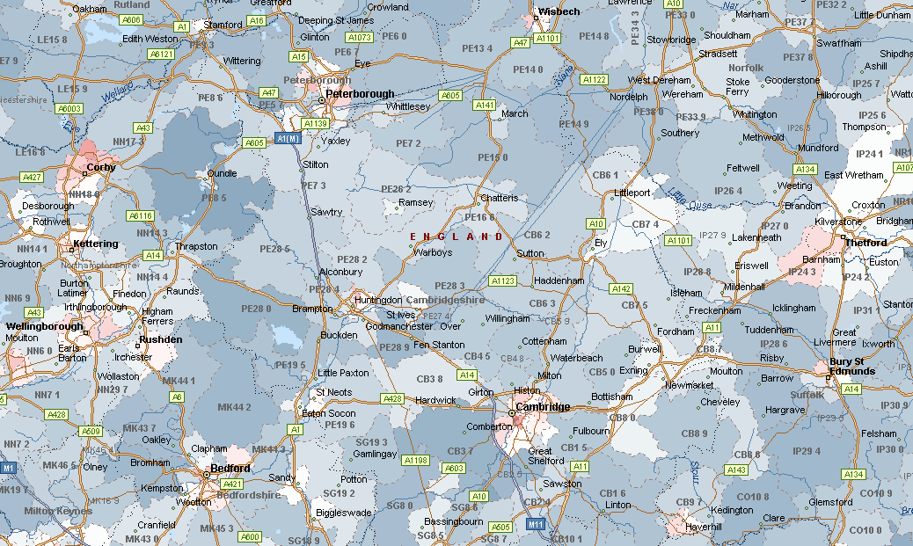
We are living longer – but local variation

Slide 15
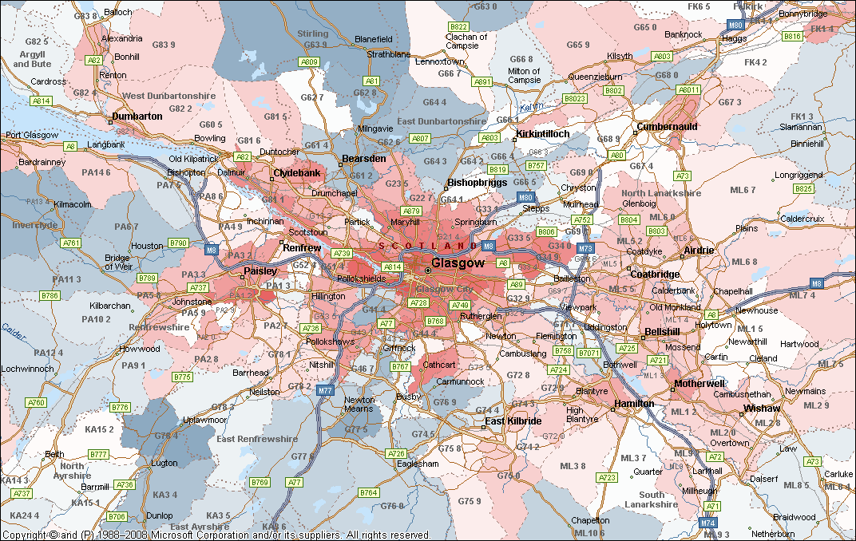
The deep fried Mars Bar effect

Slide 16
Likely impact of key drivers since 2010
Key driver | Deficit | Contribution rate
Investment returns
Market conditions
Life expectancy
New LGPS 2014
Overall Impact

Slide 17
Outlook for 2013
Compared against 2010 valuation:
Funding levels likely to be lower
Deficits likely to be bigger
(Theoretical) contribution rates likely to be higher
Recommend contributions split % of pay and £
Results will vary significantly between employers
Actuary helps Fund to work with you

Slide 18
Employer issues

Slide 19
Within each employer in the fund:
Assets and liabilities individually tracked
Deficit = Liabilities less Assets
a) Assets
Employer conts
Employer
“sub-fund”
Benefits to ex-employees
Member conts
Investment “gains”
b) Liabilities: see next few slides

Slide 20


Liabilities – employer specific
Active Membership

Slide 21


Liabilities – employer specific
Pensioners

Slide 22
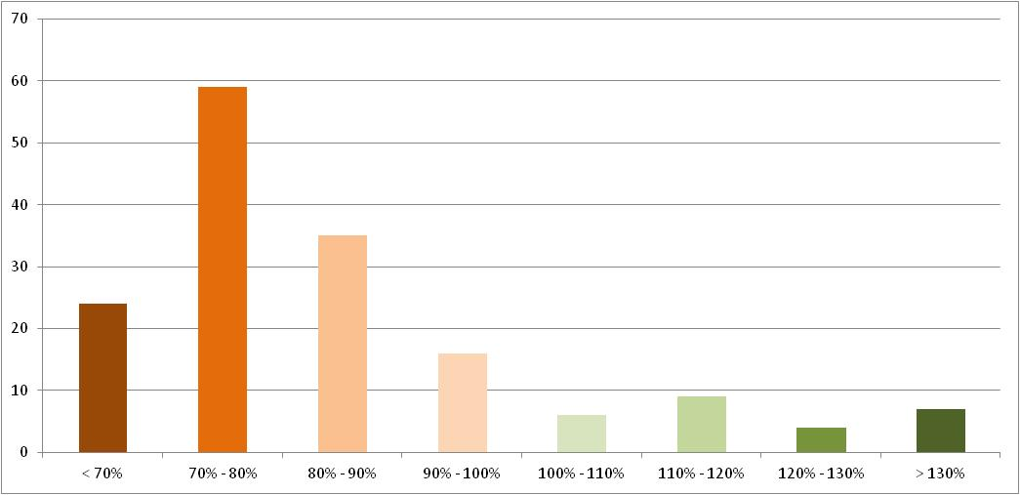

Every employer is different
Range of employer funding levels
Number of employers
Hot
spot
Funding Level
    Source: Hymans Robertson, based on Cambridgeshire Pension Fund as at 31 March 2010

Slide 23
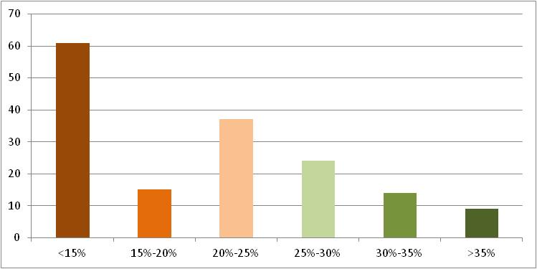
Every employer is different
Range of employer total theoretical contribution rates
Number of employers
Hot
spot
Contribution Rate (% of payroll)
    Source: Hymans Robertson, based on Cambridgeshire Pension Fund as at 31 March 2010

Slide 24
Assessing employer covenant
Issues
  What is risk of employer leaving Fund?
  What is risk to Fund if employer leaves?
Employer risk
  Tax-raising powers
  Type of body (Scheduled, TAB, CAB)
  Open or closed to new entrants
  Guarantor in place?
  Financial strength
  Funding position/size of liabilities
  Heading to cessation?

Slide 25
Less secure & shorter-term employers
Challenge: protect the Fund
avoid pushing employers into insolvency
Reconsider deficit recovery
Seek additional security
Understand the risks
Assess the likelihood of meeting target funding

Slide 26
Most secure longer term employers
Longer term view can be taken
Consider stabilising contributions

Slide 27
LGPS Reform

Slide 28
New LGPS from 2014: funding impact
 | Existing Scheme | Proposed New Scheme
Benefit Type | Final Salary | CARE with CPI revaluation
Accrual Rate | 1/60th | 1/49th
Retirement Age | 65 | State Pension Age
Member Contribution Rate | Average 6.5% Full-time equiv. pay | Average 6.5% Actual pay
Pensionable Salary | Non contractual overtime excluded | Non-contractual overtime included
Accrued rights protected (incl. retirement age, R85, final salary link)
Existing scheme underpin for members within 10 years of NPA (age 65) at 1 April 2012 (“best of”)
Introduction of a “50/50” option to bolster LGPS participation

Slide 29
Impact on benefits of LGPS reform
Assume CPI = 2.0% p.a. Salary Growth = 4.0% p.a.
Example 1
Member aged 45, Expected to retire at 65, Salary £18,000
Expected pension earned in next year:-
Old Scheme - ¹/₆₀ x £18,000 x 1.04²⁰ = £657
£300
New Scheme - ¹/₄₉ x £18,000 x 1.02²⁰ = £545
£367

Slide 30
Impact on benefits of LGPS reform
Assume CPI = 2.0% p.a. Salary Growth = 4.0% p.a.
Example 2
Member aged 60, Expected to retire at 65, Salary £18,000
Expected pension earned in next year:-
Old Scheme - ¹/₆₀ x £18,000 x 1.04⁵ = £365
£300
New Scheme - ¹/₄₉ x £18,000 x 1.02⁵ = £405
£367

Slide 31
LGPS 2014 impact on employers
Taken in isolation...
No impact on existing deficits (past service)
  Accrued rights to 2014 are protected
Modest savings on new benefits (future service)
  c1%-2% of pay across whole fund?
Savings will vary by employer:
  Depends on membership profile
  Changes to member contributions
  Take up of “50/50” option pay profile
... but cannot take in isolation!

Slide 32
Proposed changes to State Pension

Slide 33
Proposed changes to State Pension
Contracting out abolished (2017 at the earliest)
Single tier pension for all (£144 per week)
Current basic state pension = £107.45 per week
Contracting out NIC rebate removed

Slide 34
Contracting Out NIC Rebate
Applies to gross salary between £5,564 and £40,040 (in 2012/13)
Employer rate is 3.4% (in 2012/13)
Employee rate is 1.4% (in 2012/13)

Slide 35
When you leave here today...

Slide 36
Next steps
Pensions reform to be finalised
Accurate and timely data to be submitted
Fund acknowledges different types of employer
Increases in contributions probably required
Keep in close touch with the Pensions Team!!

