Slide 1
Cambridgeshire Pension Fund
Impact of data
Geoff Nathan
15 October 2014

Slide 2
Agenda
Background
Employer lifecycle
Data requirements
Impact of incorrect data

Slide 3
Cambridgeshire Pension Fund
More than 65,000 members
Managing assets of £1,905m*
Over 100 employers
A few pensioners over 100!
Shared resources and expertise with Northamptonshire Pension Fund
*as at 31 March 2013

Slide 4
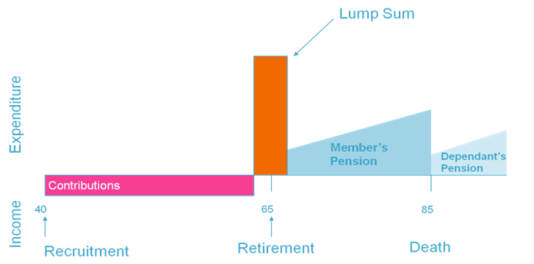
Valuing a single member

Slide 5
Valuing all members
Source: Sample LGPS fund

Slide 6
Employer lifecycle
Exit
Imminent exit
Cessation
Ongoing
Indicative cessation
Bond renewals, valuations and accounting
Admission
Procurement
Contributions and bonds
Pensions Information Memorandum (PIM)

Slide 7
How do we impact on the results?
£££
Financial
Salary increases
Pension increases
Discount rate / future investment return
Demographic
Longevity
Early leavers
Retirement age
Dependants

Slide 8
How do you impact on the results?
DATA
DATA
DATA

Slide 9
What membership data should be stored?
Name
Date of Birth
Officer/Manual Worker
Certificates of Protection
Sex
NI Number
Final Pay
Title
Pensionable Pay
Changes
Maiden name
Date of Leaving
Marital Status
Date of Joining
Employer code
Additional Contributions
Spouse’s details
Reason for leaving
Postcode
Year end info
Opt-outs
Added Years
Full-time Hours
Part-time Hours
C/O Earnings
Augmentation
Contribution Rate
Opt-ins
NI Class
Service Credit - transfers

Slide 10
Impact of inaccurate data
Scenario | A | B | C | D
Sex | M | M | M | M
DOB | 01/01/1965 | 01/01/1956 | 01/01/1965 | 01/01/1965
Pensionable salary | £25,000 | £25,000 | £52,000 | £25,000
Date of Joining | 01/01/1989 | 01/01/1989 | 01/01/1989 | 01/01/1998

Slide 11
What membership data should be stored?
Name
Date of Birth
Officer/Manual Worker
Certificates of Protection
Sex
NI Number
Final Pay
Title
Pensionable Pay
Changes
Maiden name
Date of Leaving
Marital Status
Date of Joining
Employer code
Additional Contributions
Spouse’s details
Reason for leaving
Postcode
Year end info
Opt-outs
Added Years
Full-time Hours
Part-time Hours
C/O Earnings
Augmentation
Contribution Rate
Opt-ins
NI Class
Service Credit - transfers

Slide 12
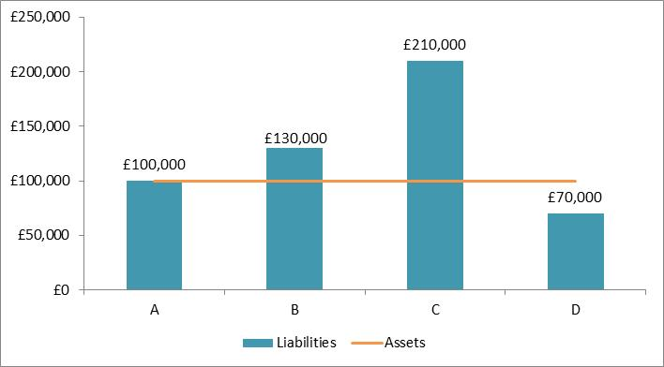
Impact of inaccurate data: liabilities
(Date of Birth)
(Pay)
(Date Joined)

Slide 13
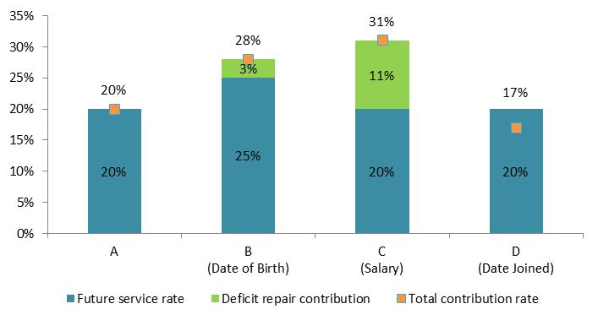
Impact of inaccurate data: Contributions
-3%

Slide 14
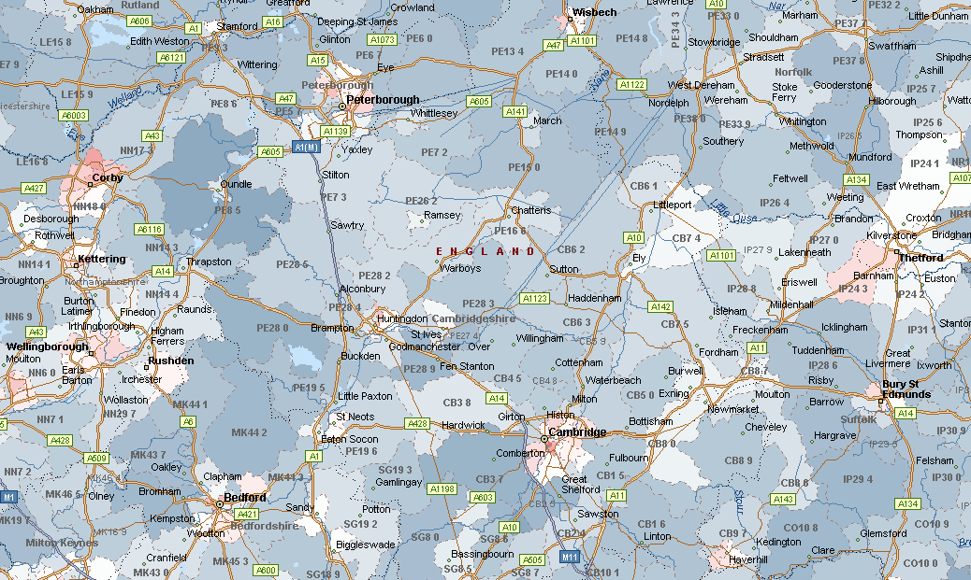
Vita’s lifestyle effect
(postcode effect)
High life expectancy
Mid life expectancy
Low life expectancy

Slide 15
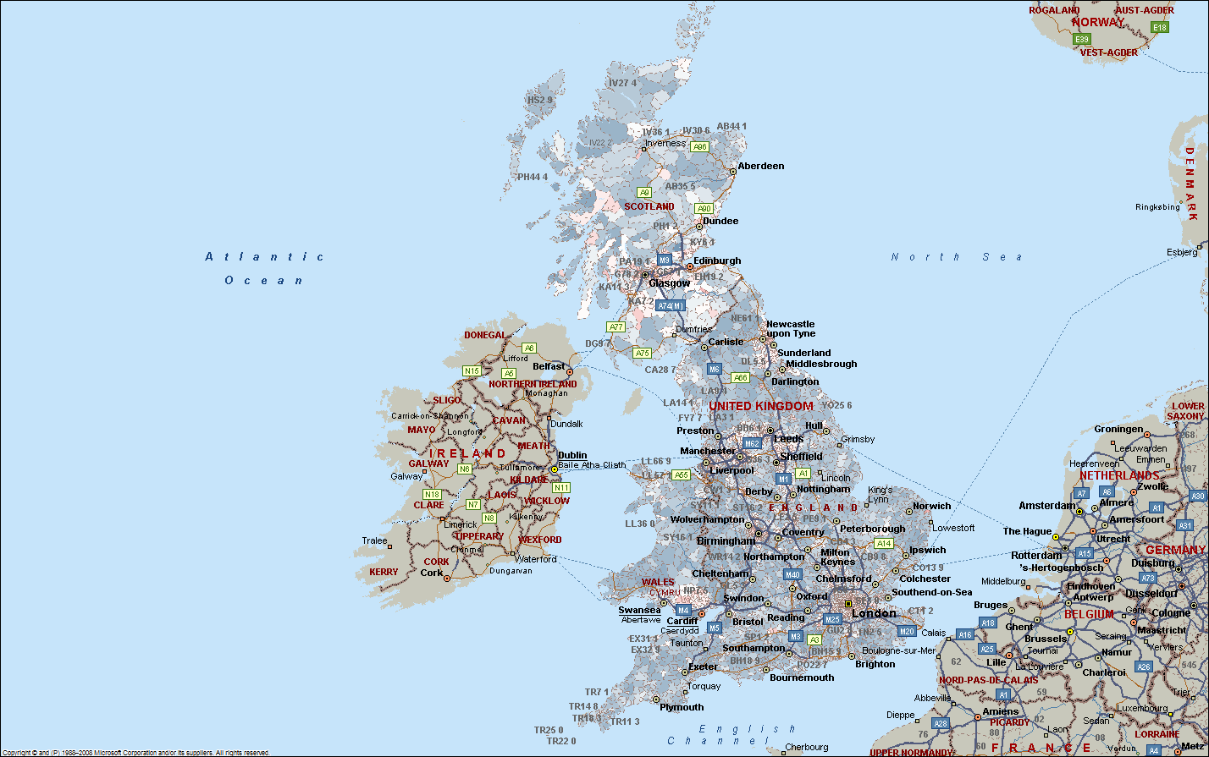
Vita’s lifestyle effect (postcode based)
High life expectancy
Mid life expectancy
Low life expectancy
PH1 2AF
PH1 2AE
Source: Club Vita research based on VitaBank as at January 2013

Slide 16
Employer lifecycle
Exit
Imminent exit
Cessation
Ongoing
Indicative cessation
Bond renewals, valuations and accounting
Admission
Procurement
Contributions and bonds
Pensions Information Memorandum (PIM)

Slide 17
What else could it impact?
Benefits
Benefit statements
Finances of the employer
Regulator
Penalties

Slide 18
In summary
Data is crucial
Need accurate information from you

Slide 19
Thank you

