Slide 1
Pensions Appeal Process
Richard Sultana
Employer Liaison Officer

Slide 2
Agenda
Introduction
What is the appeal process
Internal Dispute Resolution Procedure
Key points of the IDRP
Stages of the IDRP
Case studies
Where to find more information

Slide 3
Why do we need IDRP
Whenever a member or a prospective member disputes a Pension decision you have made = IDRP
You have an obligation to inform the member ... How, Why and Where?
Being a good employer by having clear and concise communication with your employee.

Slide 4
What is the Pensions Appeal Process?
Internal Dispute Resolution Procedure
Who could be involved in the IDRP process?
The Member
The Pensions Advisory Service (TPAS)
You (The Employer)
Administrating Authority
Pension Ombudsman
Can you tell me how many stages there are in the process, and what each stage is called?

Slide 5
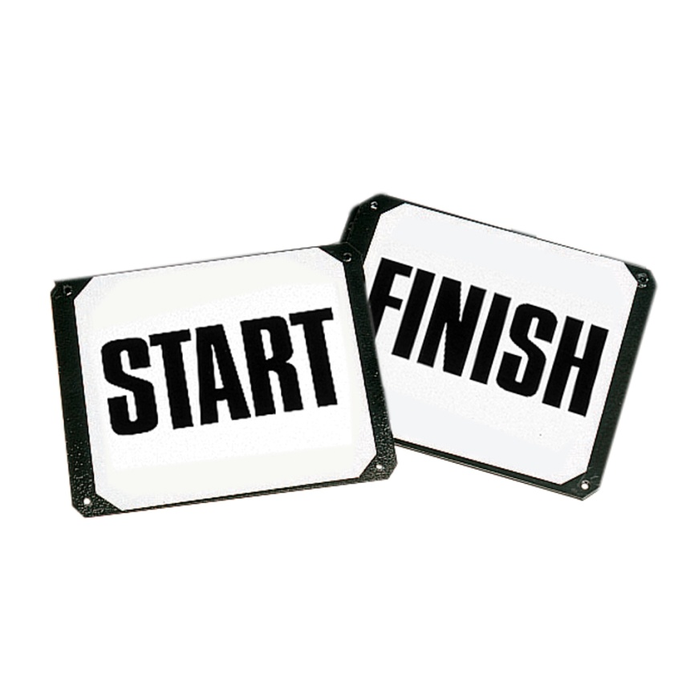
Internal Dispute Resolution Procedure (IDRP)
It is a 4 stage appeal process from start to finish (If it goes the distance)
Stage 1 – An Informal stage
Stage 2 – A first, formal stage
Stage 3 – A second, formal stage
Stage 4 – A final referral to the Pensions Ombudsman

Slide 6
As employers you have to make a number of pension decisions which affect a members benefits. Do you know which decisions you make a member could possibly dispute?
Decisions which a member may dispute can be from the following areas:
Entry to the scheme
Ill Health retirement
Redundancy Retirement
Flexible Retirement
Awarding additional pension

Slide 7
Key Points of the IDRP process
Provide ‘Disputing an employers decision’ leaflet with any communication notifying a decision
Always try to resolve informally first
Explain the reasons behind all decisions made
Appoint an Adjudicator for your formal stage IDRP cases

Slide 8
Stage 1 – Informal stage
Member will contact the person stated on the communication they have received, which has informed them of the decision
Majority of disputes are resolved at this point
Member must be given the decision makers contact details on the notification
For further technical explanation of the decision = Contact LGSS Pensions
Communication is key

Slide 9
Stage 2 – First, formal stage
If the member is not satisfied by the response received at the informal stage, then you will need to start the formal IDRP process
Question ...
In order to start this stage the member would need to put the details of the dispute in writing to their employer within a certain amount of time since they were told of the decision. Do you know how long they have to make this request to you?
Answer ...
Within 6 months of the day they were told of the decision they are wishing to dispute. This time limit may be extended based on the adjudicators decision.

Slide 10
Stage 2 – First, formal stage
Informal stage > First, formal stage
Stage 2: The start of Formal proceedings
What will you need to receive from the member
The Adjudicator – Role within the process
Provide a response within 2 months (Full or Interim)

Slide 11
Stage 2 – Adjudicators decision
Once your adjudicator has reached a decision they will need to notify the member in writing, copying in both the employer and administering authority
What should be covered in the decision notification to the member?
The Adjudicators findings will determine the next course of action

Slide 12
Stage 3 – Second formal stage
Informal stage > First, formal stage > Second formal stage
It’s at this stage that the member will need to address the administering authority to take a look at the dispute
Either the Adjudicator will not have upheld the members complaint or a deadline for a decision has not been met
As an employer you need to be aware of the time frames and ensure that any dates specified have been met

Slide 13
Stage 3 – Second formal stage
What are your responsibilities as the employer at this stage?
The outcome of this stage may have an impact on you depending on what the LGSS Director of Law & Governance decides.
There are two possible outcomes that can come from the Administering Authority.

Slide 14
Stage 4 – Final referral to the Pensions Ombudsman
Informal stage > First formal stage > Second formal stage > Pensions Ombudsman
The Pensions Ombudsman is totally impartial and the last resort for the member
The Pensions Ombudsman’s decision is final

Slide 15
Complaints!
Can you tell me which area of pensions causes the IDRP process to be called upon the most?
Ill Health retirement cases

Slide 16
Ill Health Retirement & IDRP
The IDRP Process is called upon the most when Employers have made decisions relating to Ill Health retirement.
Group Activity (15mins)
Working together in groups, please work through the question sheets in front of you.

Slide 17
Contact Details
Employer’s Team
Cory Blose Employers & Systems Team Manager
Richard Sultana Employer Liaison Officer
Mark McAuliffe Employer Liaison Officer
Kate Escudier Pensions Officer
Amy Hughes Pensions Officer
Tel: 01604 364621
E-mail: penemployers@northamptonshire.gov.uk
Web: pensions.cnorthamptonshire.gov.uk

Slide 18
Questions
Thank you for attending the workshop today

