Slide 1
LGSS Pensions Update
Mark Whitby
Head of Pensions

Slide 2
Fund developments
Fund performance
Asset pooling: ACCESS
Payroll migration
Self-service

Slide 3
Whole Fund Performance

Slide 4
Fund Asset Structure at 31 December 2015

Slide 5
Investment Managers at 31 December 2015

Slide 6
Asset pooling: the journey so far
Summer 2015 Budget – ‘...administering authorities [must] pool investments to significantly reduce costs, while maintaining overall investment performance...local authorities to come forward with their own proposals to meet common criteria for delivering savings’.
Autumn statement - Creation of 6 “British Wealth Funds” each with:
Asset pool(s) that achieve the benefits of scale (min £25bn)
Strong governance and decision making
Reduced costs and excellent value for money
Improved capacity to invest in infrastructure
Initial stages – reporting
19 February: commitment to pooling
15 July: full detail including projected savings

Slide 7
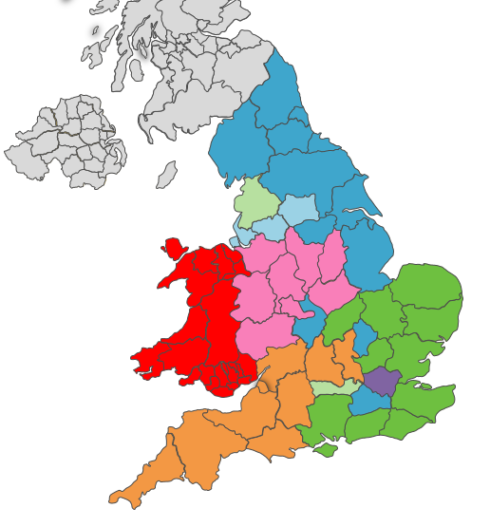
February pooling proposals
Legend
ACCESS
Border to Coast
Brunel / SW+
Central
Lancs/LPFA
Northern Powerhouse
London
Wales
Scotland/NI/IoM

Slide 8
Our asset pool:
 | Authority £m | Cumulative £m
Cambridgeshire County Council | 2,268 | 2,268
East Sussex County Council | 2,740 | 5,008
Essex County Council | 4,906 | 9,914
Hampshire County Council | 5,111 | 15,025
Hertfordshire County Council | 3,560 | 18,585
Isle of Wight Council | 483 | 19,068
Kent County Council | 4,515 | 23,583
Norfolk County Council | 2,930 | 26,513
Northamptonshire County Council | 1,850 | 28,363
Suffolk County Council | 2,193 | 30,556
West Sussex County Council | 2,964 | 33,520

Slide 9
What does an asset pool look like?
Individual
Funds
Pool
Service
providers
Fund 1
Assets
Pool Joint Governance committee (EMs)
Managers (internal/external)
Fund 2
Assets
“Operator”
Fund Administrator
Pooled vehicle(s) (eg build or rent ACS)
OR
IMAs with managers (use their vehicles)
Audit, tax, legal
Fund 3
Assets
Depositary/ Custodian

Slide 10
Implications of pooling
Elected members from constituent funds will oversee the ACCESS pool
Target date 1 April 2018 to establish pool
Backstop legislation exists to compel funds to pool
Some exemptions to pooling e.g. close ended funds, Direct Property
Role of Pension Committees relatively unchanged except they will no longer appoint investment managers
National savings estimated at £200m-£300m per annum, local savings being modelled
Should result in downward pressure on employer rates

Slide 11
Other developments: Payroll migration
Pensions payroll moving from Oracle to Altair payroll
Altair is our modular pensions administration platform:
- Database, Calculations, Imaging, Workflow,
Self-service, Payroll
Parallel running June/July, Live August 2016
Integrated solution
- Reduced double keying, errors and reconciliations
- Reduced cost

Slide 12
Other developments: Self-service
Employer self-service (ESS) now being used by around half of scheme employers
Thousands of secure ESS transactions each year: new starters, updates, leavers, etcetera
Member self-service (MSS) - we are moving to electronic issue of active annual benefit statements
Final MSS invite letter has been issued to scheme members
MSS take up still below expectations - yet only 200 members opted out of electronic statements
Encourage employers and members to use self-service facilities

