Slide 1
LGSS Pensions Forms Workshop
Kate Escudier
Employer Liaison Officer

Slide 2
What we will cover:
Common issues and mistakes our teams encounter from the forms submitted
More unusual elements of the forms you may struggle with
By the end you will:
Help improve the customer's journey
Know the common mistakes to look out for
Better understand the more unusual aspects of the forms
Notes:
Helping to improve the customer journey, appreciate it’s a complex scheme.

Slide 3
Why do you ask for so much information?
Member benefit administration
2014 scheme based on CARE pay
2008 scheme based on Final Pay
1998 scheme based on Final Pay
Valuation purposes
Employer contribution rates
Contribution payments reconciliation
Good governance
Increased scrutiny e.g Pensions Regulator and Scheme Advisory Board
Notes:
Break down to: It’s a complex scheme: 3 areas: administering the benefits – pottnailly 3 x lts of calcualtions 1/49ths career average, 60th 80th based on final pay.
For valuation purposes: setting conts rate and reconciling conts paid, so you don’t have to pay more than you have to as an employer
Good governance – need to have nenough information to amdiiter the shcme – refer to TPR Code of Practice.
We need to have each employment recordeded seprertaely – each role separate -

Slide 4
Pay Definitions – most common mistake
Pensionable Pay: overall term used for pensionable pay actually received by your members
Assumed Pensionable Pay – replaces pensionable pay for periods of reduced or no pay due to sickness/injury, ordinary child related leave and reserve forces service leave
Cumulative Pensionable Pay: Used to calculate members benefits
Combination of Pensionable Pay and Assumed Pensionable Pay
Final Pensionable Pay: used to calculate benefits for pre 2014 service
Notes:
Point to PP webinar – point out differences between the types of PP

Slide 5
Other common errors
Identification of the correct member record
Issues which prevent the correct calculation of benefits
Missing information
Notes:
MIF and Expression of wish – quite often missed off
Change to commom mistakes: coreectly identiftying the correct record; issues which prevent us from correctly calaulting the members beneifts
these are found on the starer, leaver & variation forms

Slide 6
Identification issues: Starter forms
Notes:
Common issues: Name of employer – ensure this is correct! If converted to an academy choose the right one.
Pay reference: this must be unique per employment – if the member has more than one job with you, must have 2 differing pay references
Job title: helping you to identify the member later

Slide 7
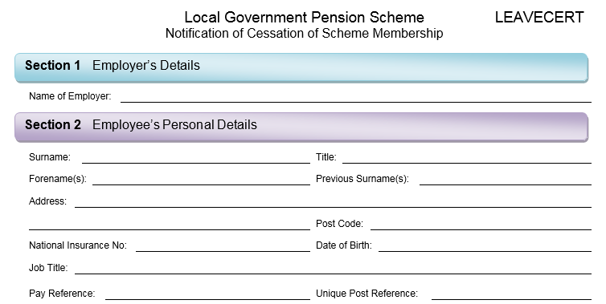
Identification issues: Leavers certificate
Identification of the member
May have more than one employment with you or other organisations
Notes:
Again the

Slide 8
Identification issues: Variation form
Notes:
Common issue: 1. you must select one of the changes for the form to ‘release’ the section it applies too.
Use the exact same pay reference as previously recorded otherwise duplicate records may be set up
Need addresses and spoiuse so we can correctly caulacte spouse benefits
Protection/Underpin means we require notification of any changes/absence periods for many individuals
Including personal details
Complete a variation form to notify us of these or via monthly interface

Slide 9
Benefit calculation issues : Starter forms
Notes:
Common issues:
1. Date joined fund: not always the start date of employment– e.g short term contracts.
2. Contractual hours per week: this do not include term time adjustments
Contractual days/weeks per year: for term time staff only these are the no of weeks they get paid each year including paid holidays
FTE hours per week: what they would have worked if they worked full time
3. FTE days/weeks per year: if works less that 52.14 weeks pre year, need to fill this in. If member is not on term time contract, then how many days/weeks would the member of staff work
FTE pay: annual pay member receives and pays conts on if they worked FT
PT pay: pay member receives if they work PT and /or term time
These can lead to an incorrect calcutaltion of beneifts

Slide 10
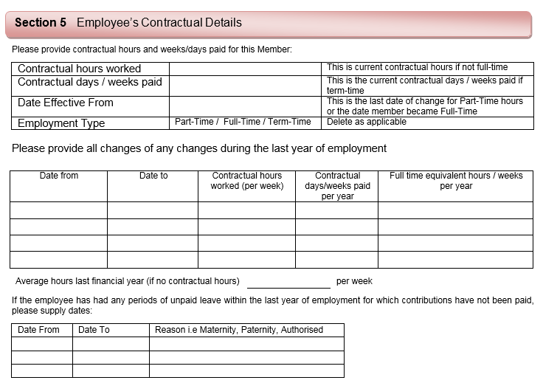
Benefit calculation issues: Leavers certificate
Notes:
The same issue can be found on the leaver forms
Sectin relates to those members subject to the underpin protection and the information needed will depend on the reason for ceasing pensionable employment (detailed in Section 3) combined with the length of LGPS membership with you and, in some cases, age.
Contractual days paid per year: common issue: This will be the contractual days/weeks worked plus their annual leave entitlement (including Bank Holidays). For part time/term time, please also quote the full time equivalent hours/weeks per year. This will be the full time equivalent for the role (e.g. 37/52.1429, 32.5/52.1429 etc).

Slide 11
Benefit calculation issues: Leavers certificate
Again the pay sections are the ones that cause the most problems
4
2016
Only input APP element not CPP: i.e. what you as the employer have based your contributions on!
Notes:
Section 4: ensure you only put the current – the from and too is reflected on your YER
CPP: This is the total of the pensionable pay and/or assumed pensionable pay in either section of the Scheme in the Scheme year (1st April to 31 March). APP: if the CPP has elements of ALL put the individual amount of APP here – NOT combined!

Slide 12
Benefit calculation issues: Leavers certificate
Remember use the 2008 pensionable pay! E.g. non contractual overtime wasn’t pensionable back then
Only use if a previous final pay figure is to be used in the calculation of the pre 1 April 2014 benefits.
Notes:
Other periods: , if their pay in one of the 2 preceding years is higher, that year should be used for Final Pay.
If, prior to 01 April 2008, they were subject to an enforced reduction or restriction in pensionable pay and a Certificate of Protection was issued and is still in force to the last day of pensionable employment ie the leaving date is within 10 years of the effective date of the Certificate, you must take into account the effect of that Certificate when assessing the period over which the estimated Final Pay is to be calculated.
If, after 31 March 2008, the member suffered a reduction or restriction in their full time equivalent pensionable pay, either voluntarily or otherwise, they can elect to use the protection under Regulation 10 of the LGPS (Benefits, Membership and Contribution) Regulations, to allow Final Pay to be determined as an average over an alternative period (a consecutive 3 year period within 13 years of leaving, ending on 31 March). If they elect to do so, you must calculate Final Pay based on this period

Slide 13
Missing information: Leavers certificate
Members are entitled to a refund of pension contributions if they have less than 2 years membership.
Require the total of the Employees contracted-out NI earnings between lower earnings limit & upper accrual point.
Notes:
More unusal information – need this to calculate members refunds if they qualify

Slide 14
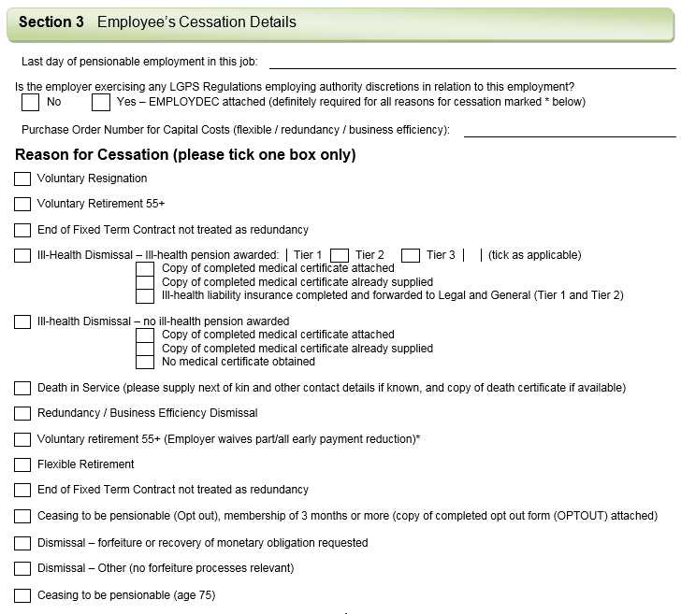
Missing information: Leavers certificate
Different cessation reasons = different LGPS rules!
Notes:
Reason for cessation – different reasons mean different rules and some come at a potential cost to you as the employer e.g.

Slide 15
Missing information: Leavers certificate
Section 6 often left blank, please complete since the assumption is the member is leaving all employments and may be deferred unnecessarily.
If they have started a new employment with you….don't forget the new starter form!

Slide 16
Employer Self Service
Can be used to inform us of leavers
Member Update >Notification of Leaver
Complete & upload a leavers cert
Documentation > Generate Member Document
Select a template > EMPLEAVEN – Employer Leaver Cert D Update > submit
Click on leaver form > Save as* > use exactly the same file name
Open > complete
Documentation > Upload Word Document
Browse >find on your own drive >open > upload
* You must keep the file name exactly the same
Notes:
Other areas are ill health forms, check website & training sessions

Slide 17
Thank You.
Any questions?

